Slide 1
Group No . 01
Capstone Project
QA for Automotive Device ( Cruise Control System)
Team Members :
Harshvardhan
Hrushikesh
Anupam
Krishna
Asha
Manish
Tahir
Trainer : Prof. Abhishek Sengupta
Date : 07th June 2024

Slide 2
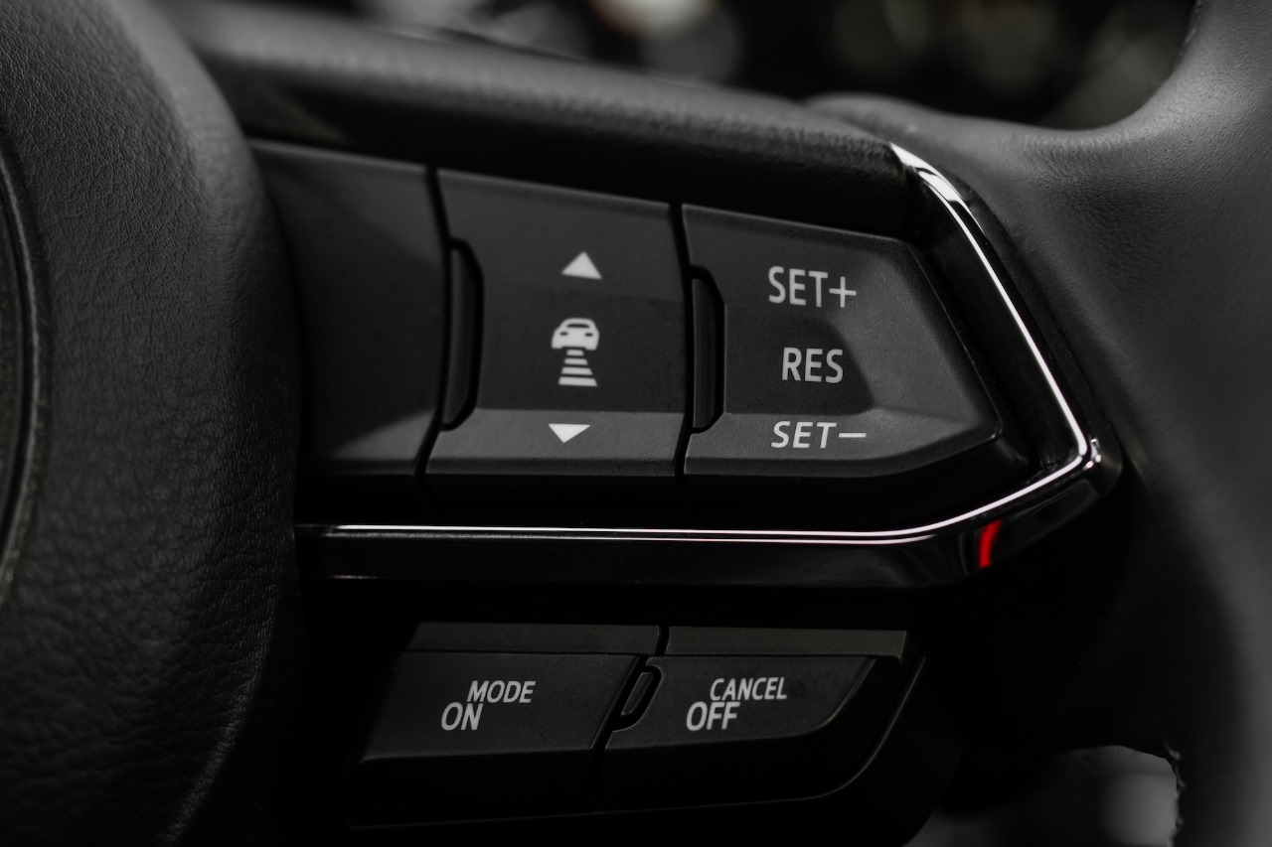
Agenda
1. Introduction to Automotive QA
2. Overview of Cruise Control System
3. Test Plan Overview
4. Functionality Flow Chart and AUTOSAR Configuration
5. Testing Methodologies
6. Traceability and Test Reporting
7. Conclusion and Q&A

Slide 3
Introduction to QA
Quality Assurance (QA) is a process for preventing quality failures. The QA team is involved in all stages of product’s development like production, testing, packaging, and delivery.
QA helps a company to create products and services that meet the needs, expectations and requirements of customers.
Importance of QA in automotive industry lies in ensuring vehicle safety, reliability, and compliance with regulatory standards.
QA Engineers play a crucial role in analyzing requirements, developing test strategies, and validating software and hardware components to meet quality standards.
Effective QA practices help reduce product recalls, warranty costs, and reputational damage, leading to increased customer satisfaction and brand loyalty.
Continuous improvement and innovation in QA processes and technologies are essential for addressing emerging challenges and ensuring competitiveness in the automotive market.

Slide 4
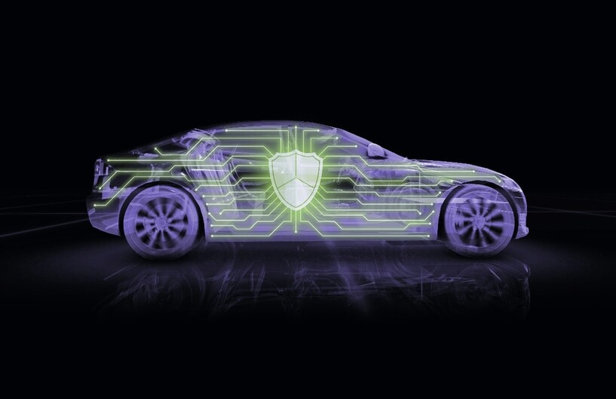
Overview of Cruise Control System
Cruise control is a system, which automatically controls the speed of an automobile. The system takes over the throttle of the car to maintain a steady speed as set by the driver.
In short, cruise control can be said to be a system which uses the principles of radar to determine the distances between two consecutive moving vehicles in which either one or both of them is incorporated with this system.
Components of Cruise Control include sensors to measure vehicle speed and road conditions, actuators to adjust throttle or braking, and control algorithms.
Integration of advanced features such as adaptive cruise control, lane-keeping assistance, and collision avoidance enhances vehicle safety and driver assistance capabilities.
Evolving technologies such as artificial intelligence and machine learning enable Cruise Control Systems to adapt to dynamic driving conditions and improve performance over time.
Collaborative partnerships between automotive manufacturers, suppliers, and technology providers drive innovation and advancement in Cruise Control System design and functionality.

Slide 5
Test Plan Overview
A well-defined test plan outlines test objectives, scope, resources, and schedule, ensuring comprehensive testing coverage and efficient resource utilization.
The primary objectives of this test plan is to validate the functional and non-functional requirements of the cruise control system, ensure its integration with other vehicle systems, and confirm its compliance with industry standards.
Expanding test scope to include edge cases and real-world scenarios helps identify potential issues and ensure the system's robustness in diverse operating conditions.
Adoption of agile and DevOps methodologies facilitates iterative testing, rapid feedback cycles, and continuous integration, enabling early defect detection and faster time-to-market.
Integration of test automation tools and frameworks streamlines test execution, reduces manual effort, and improves test coverage, scalability, and repeatability.
Levels of testing like unit testing, integration testing, system testing, and acceptance testing can be used in order to acquire good quality and performance. Also some components like Application layer, runtime environment, basic software modules and MCAL are included.
Collaboration with cross-functional teams, including developers, designers, and product managers, promotes alignment of testing efforts with business goals and customer expectations.

Slide 6
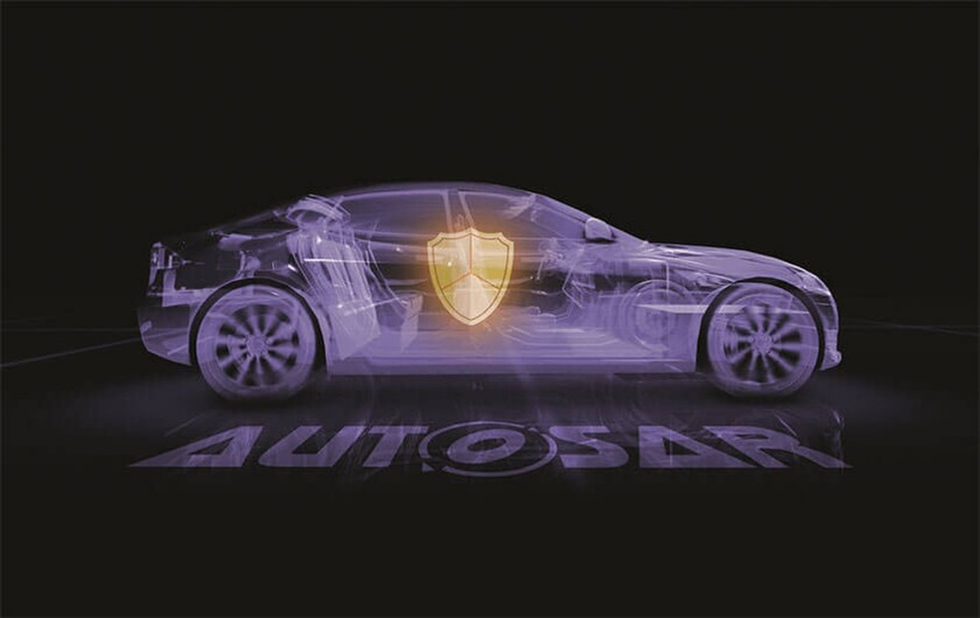
AUTOSAR Configuration
AUTOSAR standardizes automotive software architecture, facilitating interoperability between Electronic Control Units (ECUs) and enabling efficient development and integration of automotive systems.
Accurate configuration of AUTOSAR parameters ensures seamless integration and optimal performance of Cruise Control System components, enhancing overall system reliability and safety.
Adoption of model-based development approaches such as AUTOSAR-compliant tools and frameworks streamlines software design, development, and validation processes, reducing time-to-market and development costs.
Integration of AUTOSAR with other automotive standards and frameworks, such as ISO 26262 for functional safety, enhances system robustness and compliance with industry regulations and standards.
Collaboration with AUTOSAR consortium members, automotive OEMs, and suppliers fosters knowledge sharing, best practices exchange, and ecosystem development, driving innovation and advancement in automotive software engineering.

Slide 7
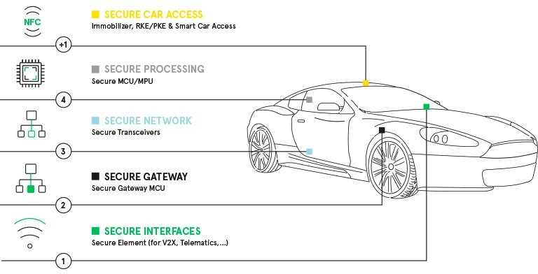

Slide 8
Functionality Flow Chart
Visualizing system functionalities through flow charts aids in understanding the sequential steps involved in Cruise Control operation, including activation, speed adjustment, and deactivation.
Incorporating error-handling scenarios and fallback mechanisms in the flow chart helps ensure system resilience and reliability in the event of unexpected situations or failures.
Iterative refinement of flow charts based on user feedback, testing outcomes, and system performance metrics enhances clarity, usability, and effectiveness in communicating system functionality and behavior.
Integration of flow charts with requirement specifications, design documents, and test cases promotes traceability, consistency, and alignment throughout the software development lifecycle.
Adoption of standardized flow chart notation and conventions facilitates collaboration, communication, and knowledge transfer among development teams, stakeholders, and domain experts.

Slide 9
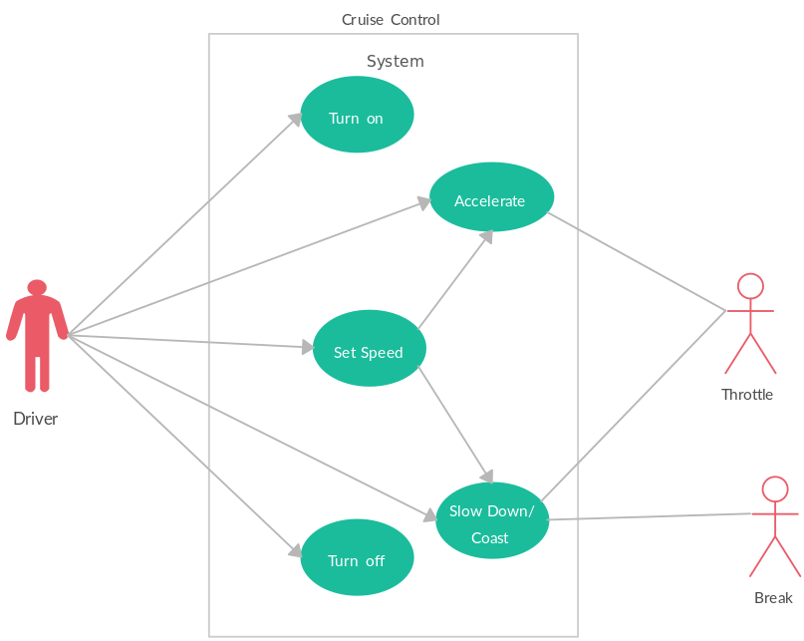
……….
…….....
………..

Slide 10
Test Results Documentation
Thorough documentation of test cases, execution logs, and observed outcomes provides a comprehensive record of testing activities and facilitates traceability and future analysis.
Integration of automated testing tools streamlines test execution and result generation, reducing manual effort and ensuring consistency and repeatability in testing processes.
Adoption of test management platforms and repositories centralizes test artifacts, metrics, and reports, enabling efficient collaboration, tracking, and analysis across distributed teams and projects.
Visualization of test results through dashboards, charts, and graphs enhances comprehension, decision-making, and communication of testing progress, trends, and outcomes.
Documentation of lessons learned, best practices, and improvement recommendations promotes continuous learning, process refinement, and quality enhancement throughout the organization.

Slide 11
Traceability Matrix
Traceability matrix establishes a clear link between requirements, test cases, and verification results, enabling effective requirement management and impact analysis.
Creating a traceability matrix for a QA (Quality Assurance) process for an automotive feature like the Cruise Control System involves mapping various requirements, test cases, and other elements to ensure comprehensive coverage.
This matrix serves as a structured document that links various elements such as requirements, test cases, and other project artifacts. Each requirement is mapped to corresponding test cases, allowing for easy verification that all specified functionalities are adequately tested
Throughout the QA process, the traceability matrix serves as a reference point for testers, developers, and stakeholders. It facilitates efficient impact analysis, change management, and compliance verification. Additionally, it helps in identifying any gaps in test coverage or inconsistencies between requirements and test cases, enabling teams to address them promptly.
Integration of traceability matrix with requirement management systems, version control repositories, and defect tracking tools promotes data integrity, visibility, and traceability across the software development lifecycle.
This matrix helps in tracking the fulfillment of each requirement through corresponding test cases and their results. Additionally, it ensures that all requirements are adequately tested, helping to validate the functionality and robustness of the Cruise Control System.

Slide 12
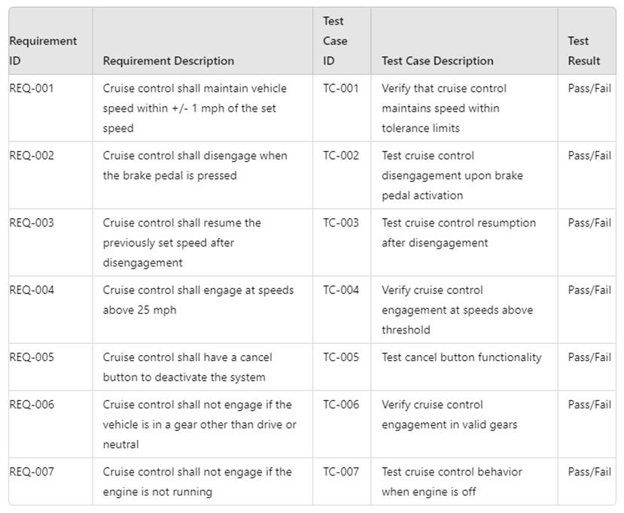
Traceability Matrix

Slide 13
Stress vs Load Testing
Stress testing is a type of software testing that verifies the stability and reliability of the system. Stress testing evaluates system robustness under extreme conditions such as high speeds, steep gradients, and adverse weather, identifying potential performance bottlenecks and failure points.
Load testing assesses system performance and responsiveness under varying traffic conditions and driver inputs, ensuring optimal operation and user experience in real-world scenarios. It checks how a system handles many users at one time like in real-life.
Adoption of performance testing tools and frameworks automates stress and load testing scenarios, enabling realistic simulation of traffic, environmental, and usage conditions.
Integration of stress and load testing into continuous integration and deployment pipelines validates system scalability, reliability, and performance across different hardware configurations and deployment environments.
Collaboration with domain experts, test architects, and performance engineers ensures the selection of appropriate stress and load testing scenarios, methodologies, and success criteria for accurate assessment and validation of system performance and stability.

Slide 14
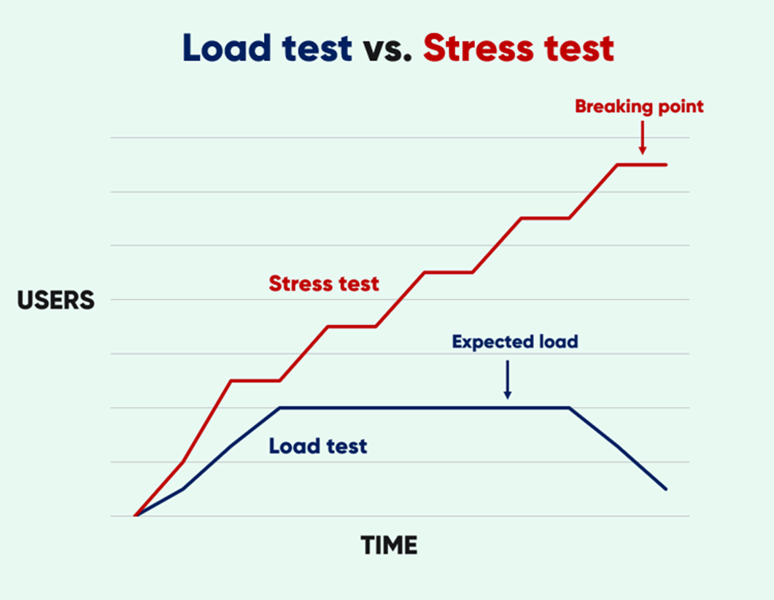

Slide 15
Test Report Summary
Test report summarizes key findings, test objectives, methodologies, results, and recommendations, providing stakeholders with a clear overview of testing activities and outcomes.
Visual aids such as graphs and charts present test metrics and performance indicators effectively, enabling stakeholders to assess system performance and make informed decisions.
Integration of test report with requirement management systems, defect tracking tools, and project management platforms ensures alignment of testing outcomes with business goals, priorities, and timelines.
Documentation of test report evolution, updates, and changes facilitates auditing, compliance verification, and knowledge sharing among project stakeholders and regulatory authorities.
Collaboration with stakeholders, including developers, testers, product owners, and project managers, ensures the accuracy, completeness, and relevance of test report content, format, and presentation.

Slide 16
Conclusion and Q&A
In conclusion, this test plan serves as a comprehensive guide to ensure that the Cruise Control System not only meets but exceeds the required standards of functionality, integration, performance, and security. By following this plan, project managers, developers, testers, and stakeholders can work together effectively to deliver a high-quality, reliable cruise control system that enhances vehicle safety and user satisfaction.

Slide 17

THANK YOU

